Slide 1
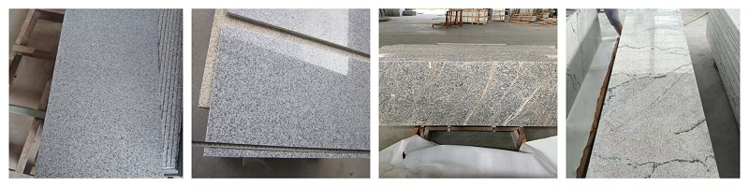
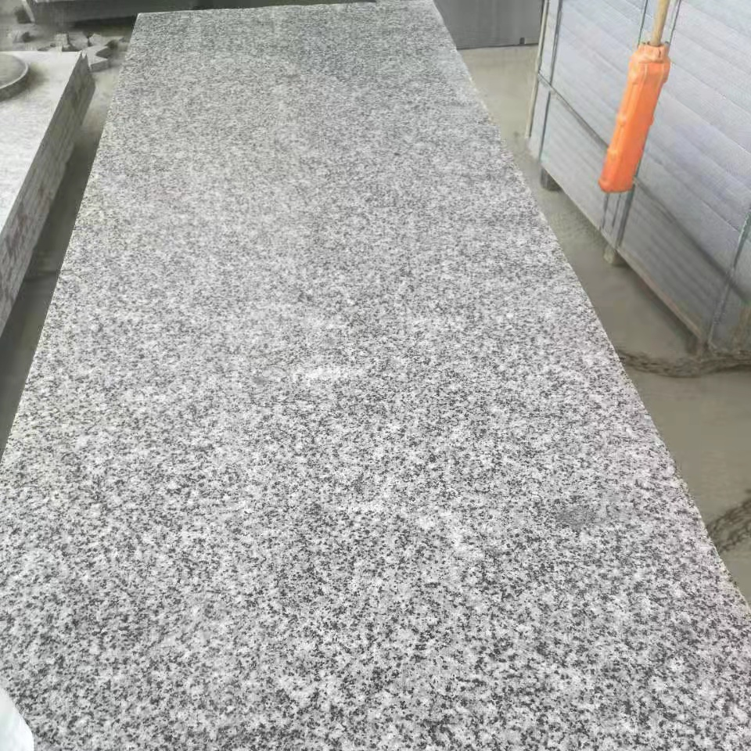
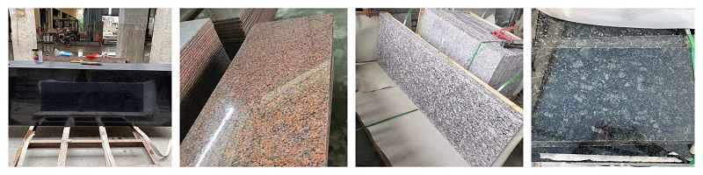
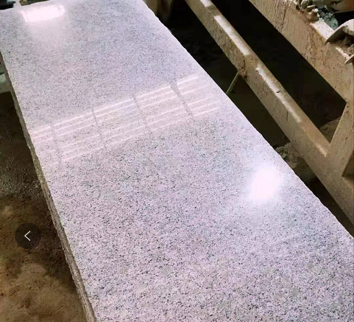
Granite Slab Catalogue
G654 G603 Multi Color Bianco Finaello G6400
Black Galaxy G562 Spray White Butterfly Green Pearl Red

Slide 2
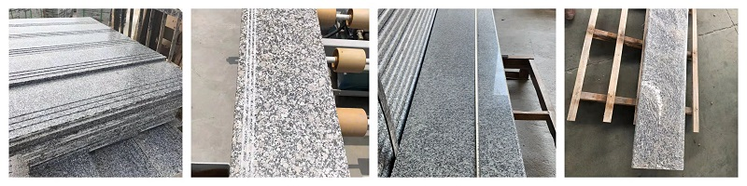
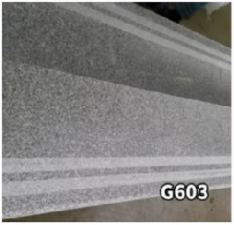
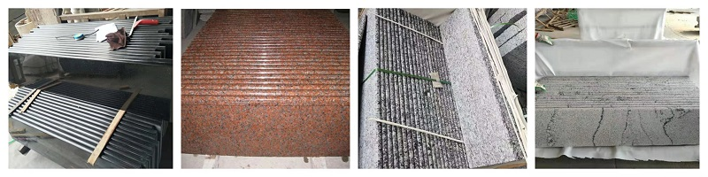
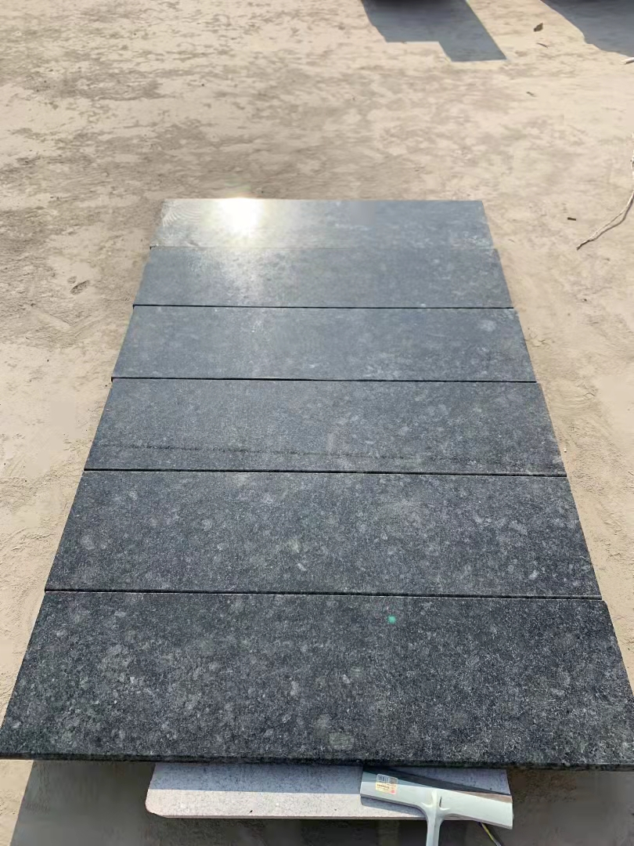
Granite Staircase Catalogue
G654 Pearl Red G6400 Multi Color G603
Black Galaxy G562 Spray White Bianco Finaello Butterfly Green

